Slide 1

Scissor lift Final Review
Ethan Rowe

Slide 2
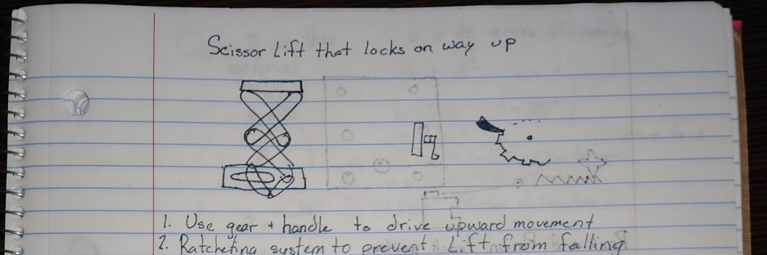
Original Design Idea
Scissor lift driven by a lead screw
Uses a ratcheting mechanism to prevent lowering motion
Impossible to design a system with a contained leadscrew as a single part

Slide 3
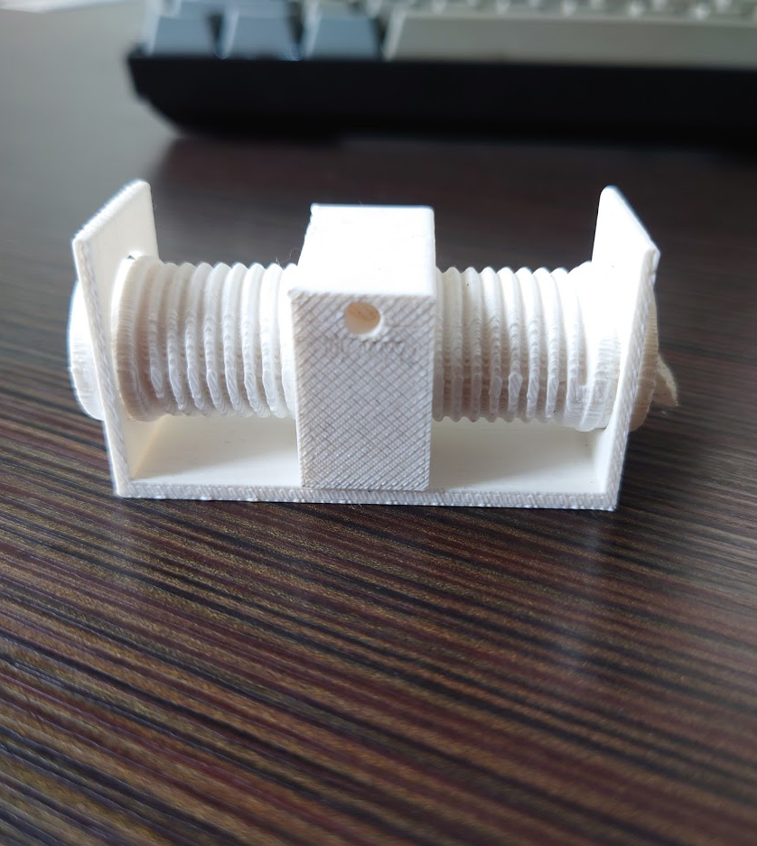
First and Second Test Print
First Print: too small and Broke
Price: 1.78
Second Print: Screw meshed with the carrier
Price 2.86

Slide 4
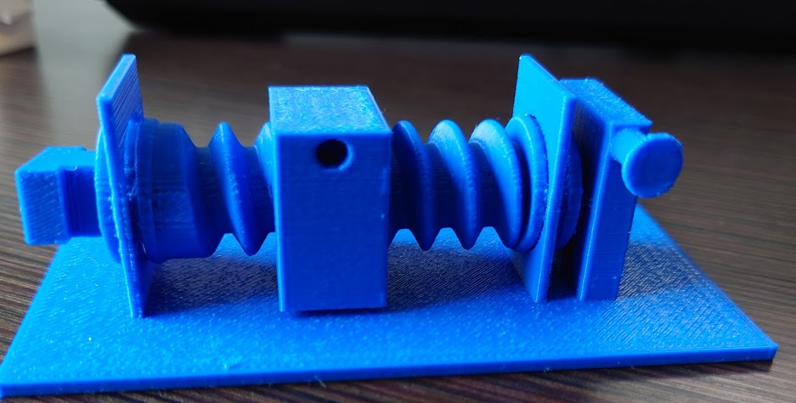
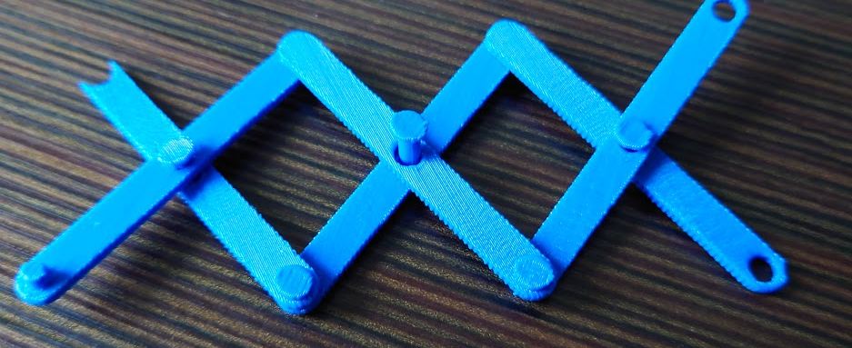
Third Test Print
Screw/Nut worked
Scissor links worked well together
Connections to carrier were incorrectly designed and snapped off
Price: 12.53

Slide 5
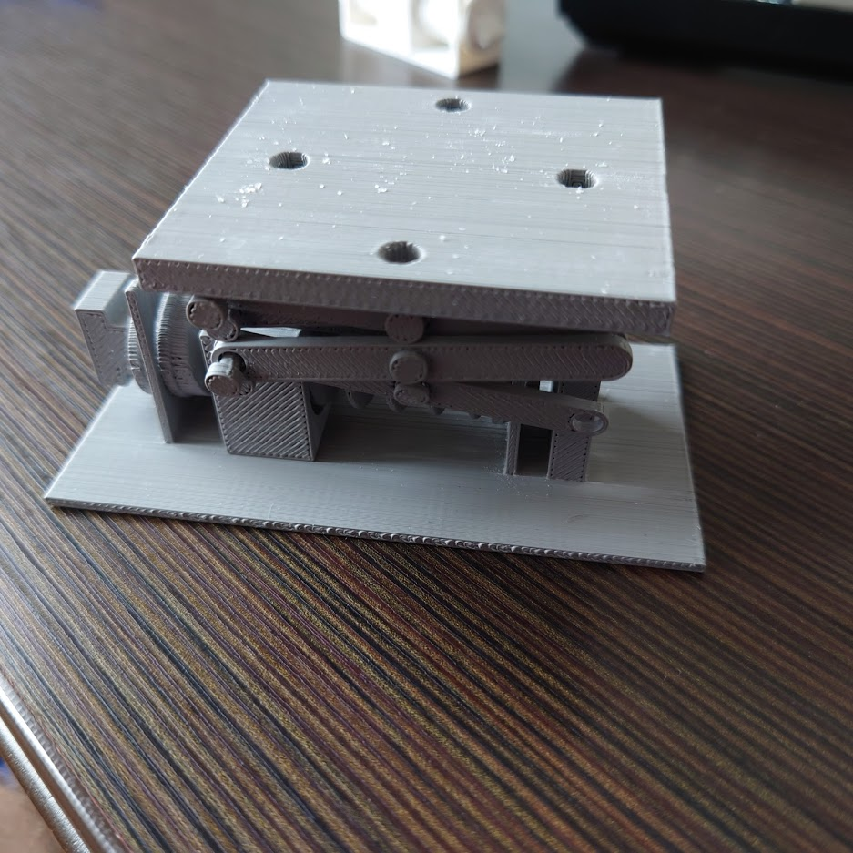
Final Print
Screw/Nut have a yet undiagnosed issues
Scissors links worked well
Attachment points to carrier were much improved
Printing imperfections left some parts more brittle and lead to snapping
Price: 20.94

Slide 6
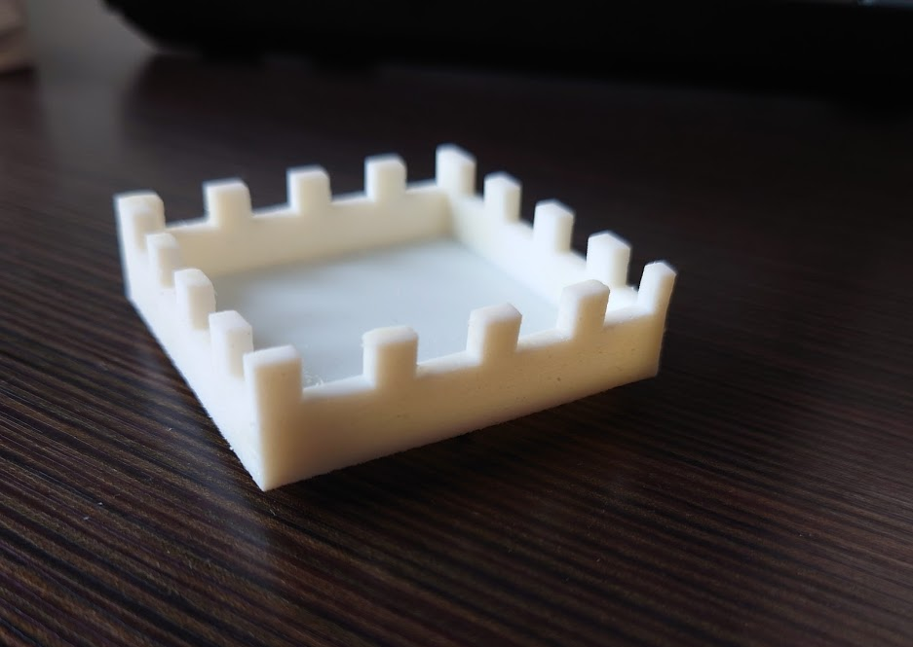
Separate Technology part
Originally chose flexible resin on Form 2
Ended up with J750 due to lack of resin
Price 5.43

Slide 7
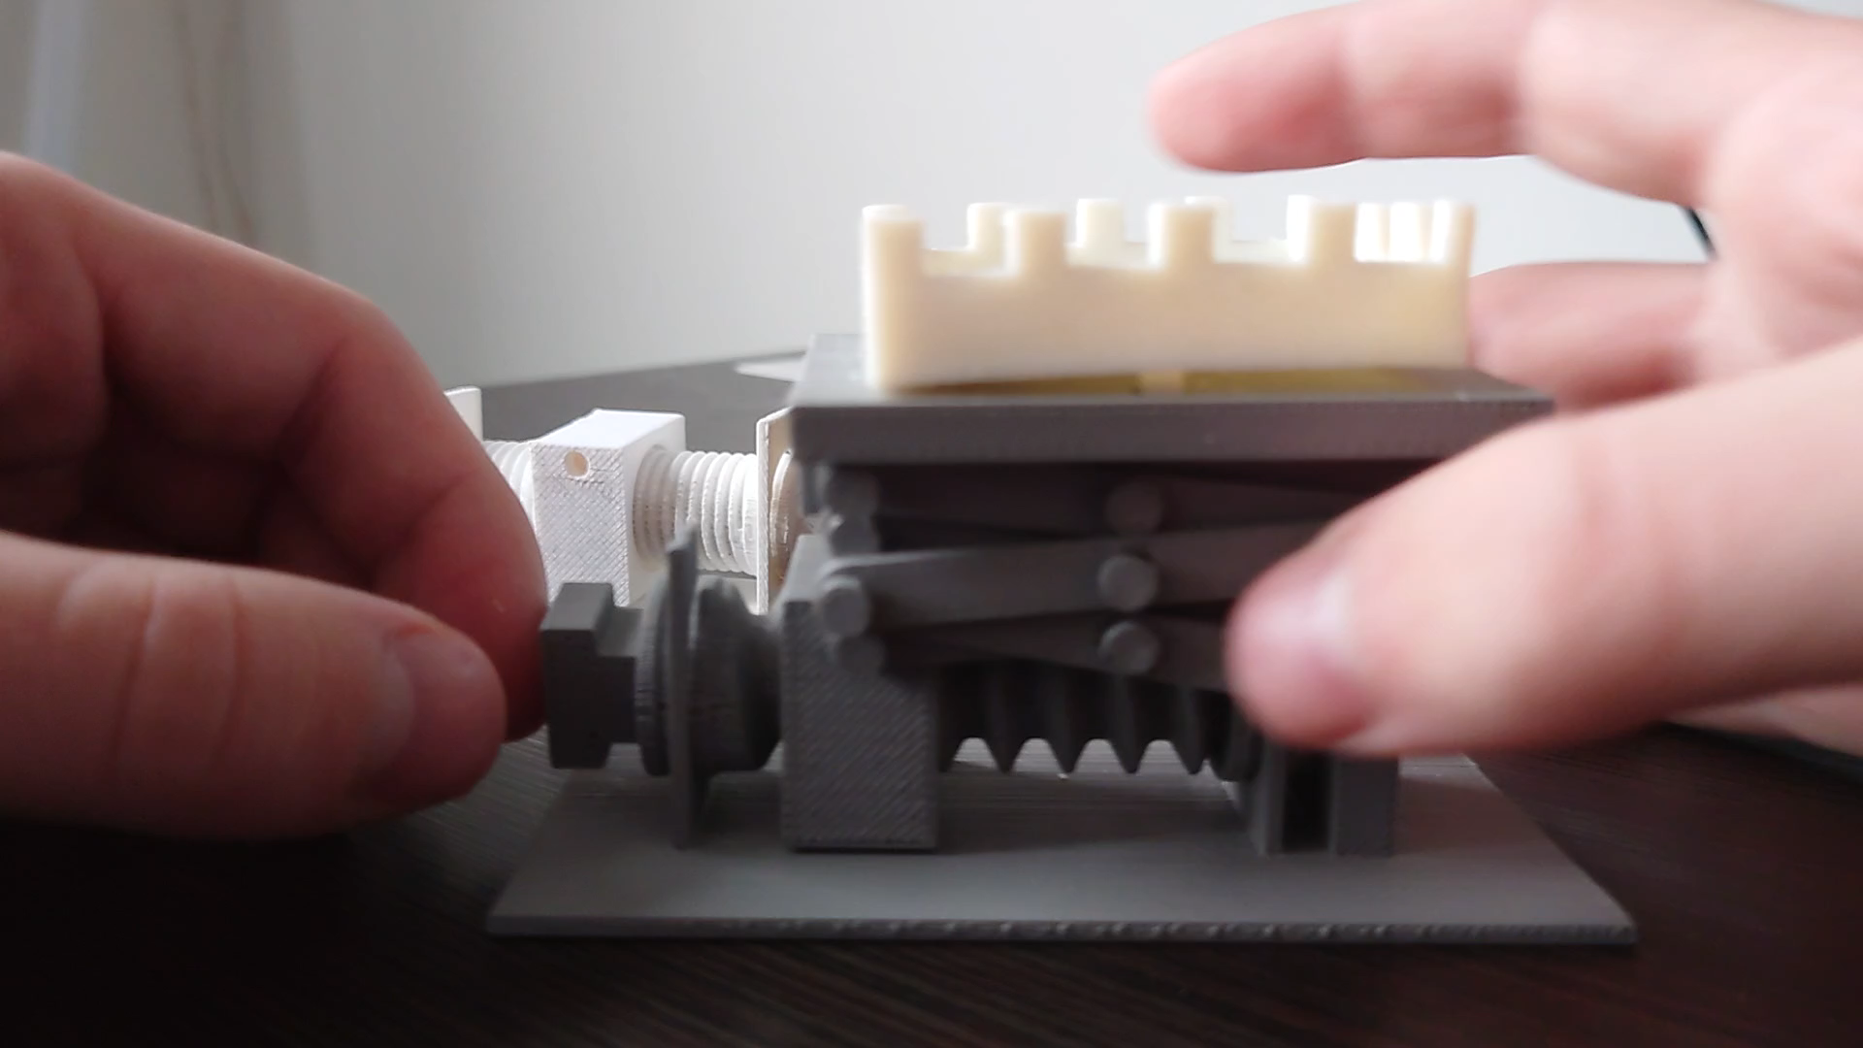
Video

Slide 8
Reflections
The positioning of the nut on the screw seems to be a vital design decision
Would choose to reprint with a much higher resolution to try and avoid some of the print failures
Will attempt to reprint in the Fall to see if these changes will help with a moveable print

Slide 9
Final Budget
Print 1
1.78
Print 2
2.86
Print 3
12.53
Print 4
20.94
Final Budget Remaining:
58.29

